Slide 1
Split-belt heel strike validation and open sim
6 June 2023

Slide 2
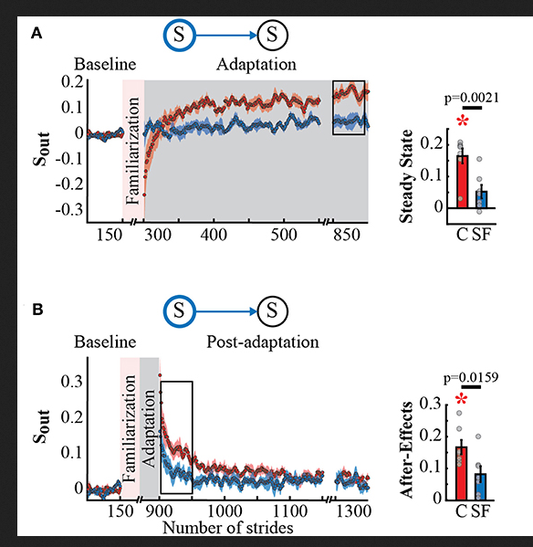
Step time asymmetry
Explicit Control of Step Timing During Split-Belt Walking Reveals Interdependent Recalibration of Movements in Space and Time
post-adaptation of T_{out}.(asymmetry with temporal feedback) Each data point in the time courses represents the average of five consecutive strides and shaded areas around the data points represent the standard errors. Bar plots indicate the mean average behavior in the epochs of interest (indicated with the black rectangles), gray dots indicate values for individual subjects, and vertical black lines are standard errors. Horizontal lines between bars illustrate significant differences between groups (p < 0.025) After-effect values of S_{out} and T_{out}

Slide 3
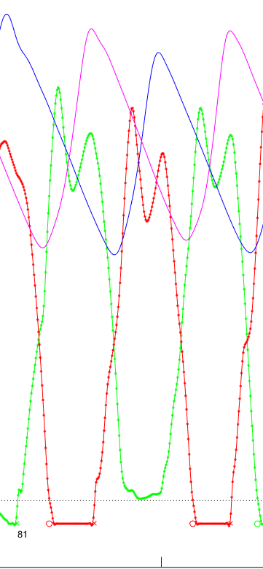
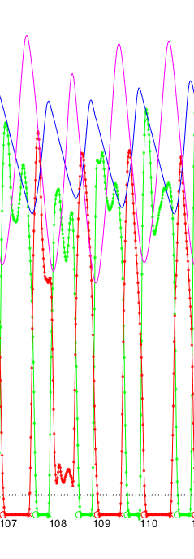
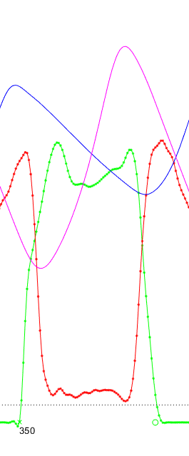
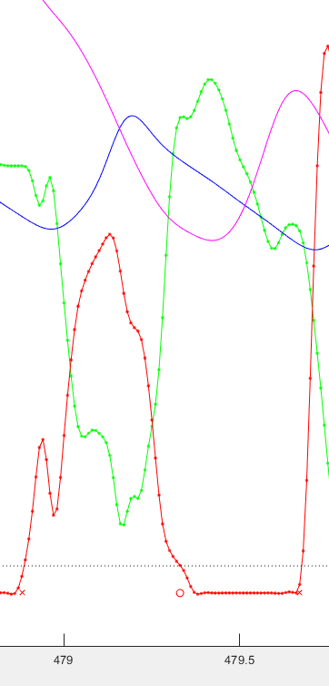
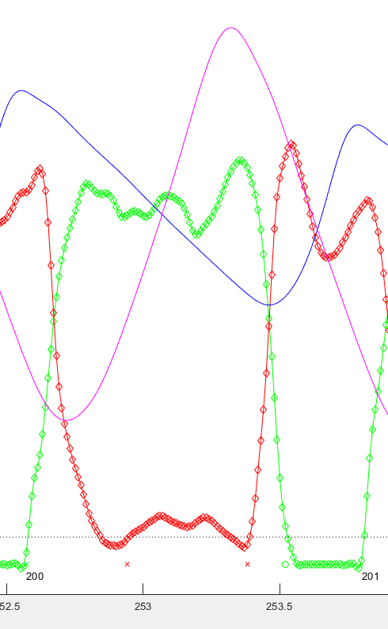
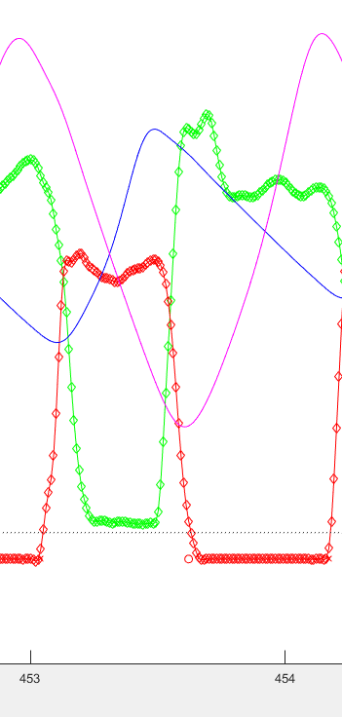
Step time issues
MLL at hs 81 in washout: not going below 50 N thresh
MLL at hs 109 in split 1: not going below 50 N thresh
MLL at hs 349 in split 1: not going below 50 N thresh
MLL at hs 454 in split 1: foot drag probably – a forceful one
MLL at hs 201 in save: double dip below threshold -> two heel strikes
MLL at hs 360 in save: not going below 50 N thresh

Slide 4
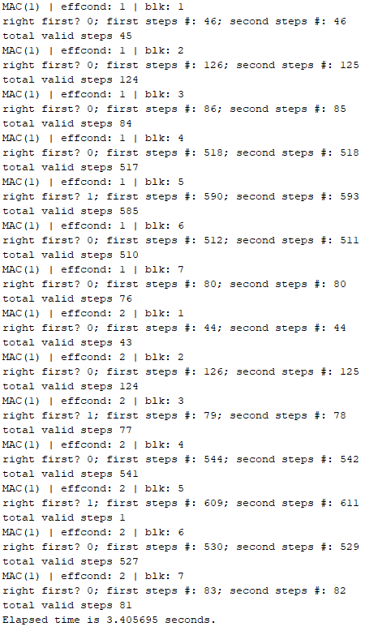
Using the hs1 – to2 – hs2 – to1 step validation method
Applied on both legs (time - based) and removed any steps (index - based) that were invalid on both legs
Not yet tested with asymmetry
Problem shows up when there is an invalid step: in that case all following steps also end up invalid
Maybe this is the point where brute force corrections come in

Slide 5
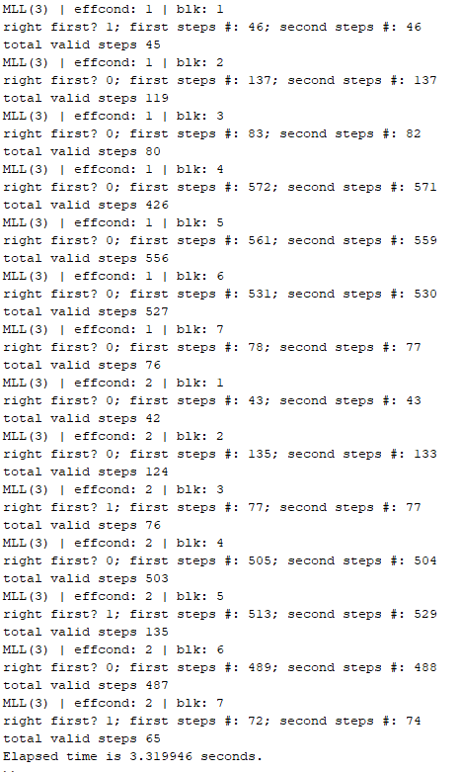
Using the hs1 – to2 – hs2 – to1 step validation method with a subject know to have problematic gait event identification

Slide 6
Using the hs only validation
Heel strike is valid only if the preceding and following heel strikes recorded are from the opposite foot

Slide 8
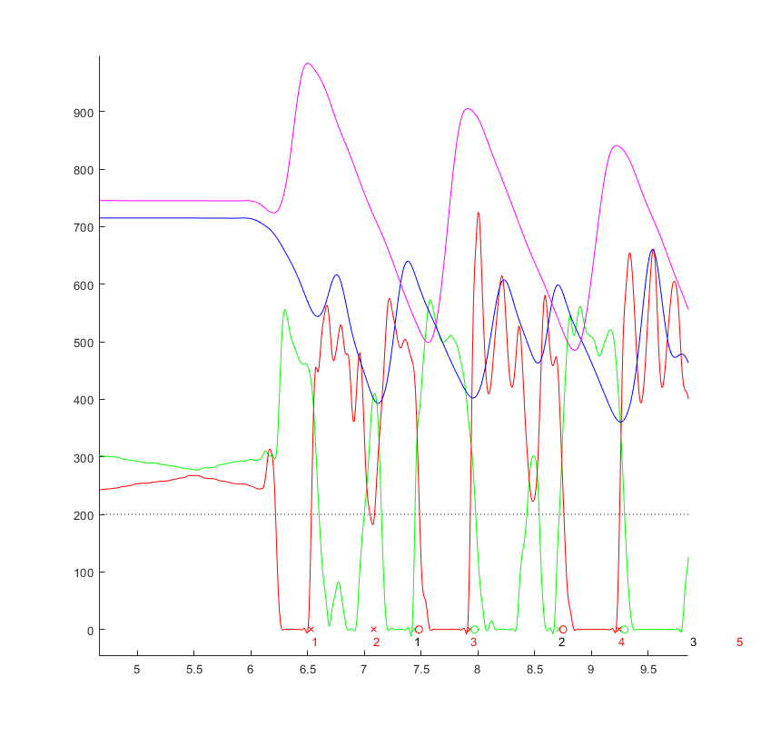
Implemented:
Brute force cleaning of heel strike vectors
Removed heel strikes detected before belt was moving
Removed some foot drag / skid (see image – red circle hs removed) but only from very early in the walking task
Identified the indices of “valid” heel strikes
for one pair of heel strikes on leg-2, find any leg-1 heel strikes falling in between
If there is only one hs found, then it is valid
There is a flag for if the index of the one hs does not match that

Slide 9
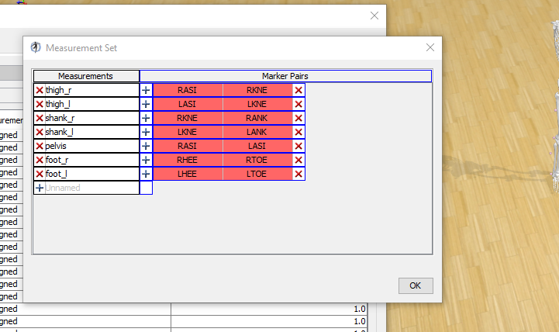

Slide 10
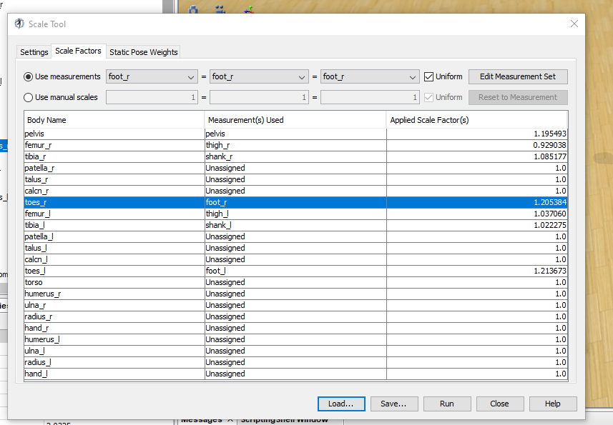

Slide 11
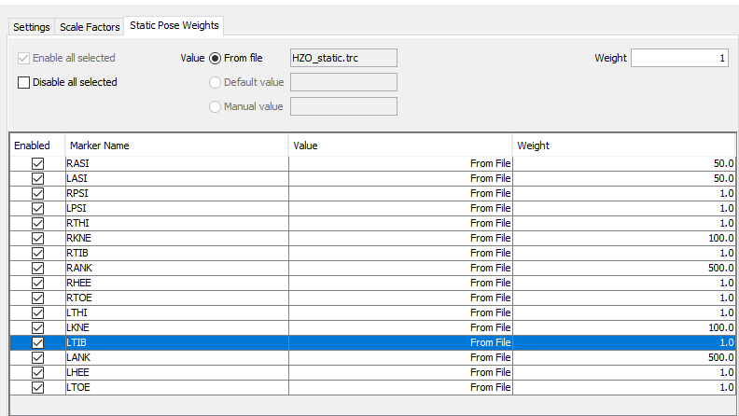

Slide 12
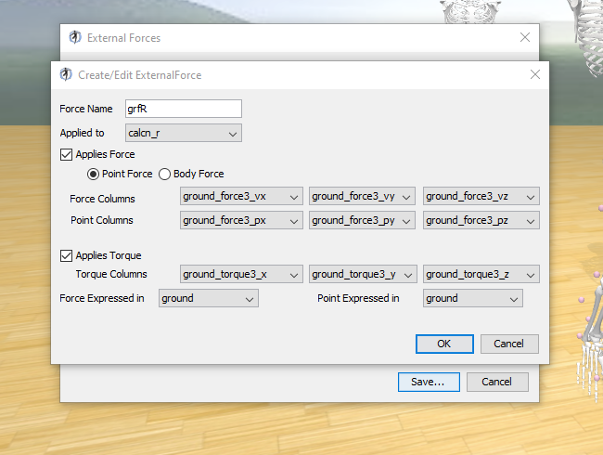

Slide 13
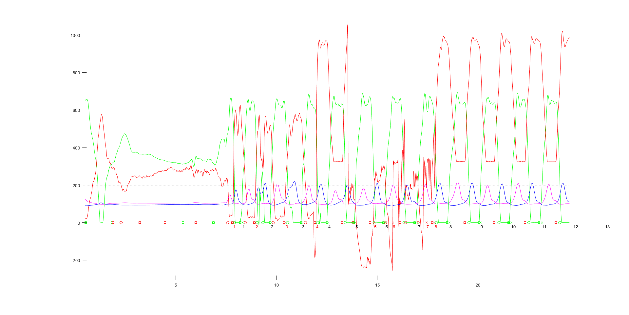
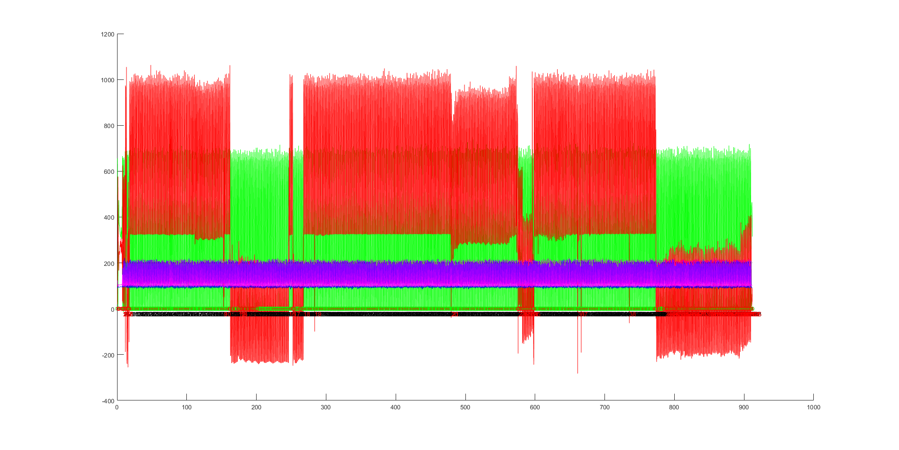
Bax effcond 1 blk 5 force plate “zero jumps several times in the middle of the collection
BAX effcond 1 data is questionable in split1 and wash 1 ☹

Slide 14
MLL
Threshold 200 N
Long hold for force switch
Baseline heel marker height + 40 mm (this is arbitrary, but less than this results in some missed early steps…maybe it should be a percentage somehow with respect to swing height)

Slide 15
MLL
Threshold 200 N
Long hold for force switch
Baseline heel marker height + 40 mm (this is arbitrary, but less than this results in some missed early steps…maybe it should be a percentage somehow with respect to swing height)
Brute force cleaning at the beginning of all trial blocks

Slide 16
MLL
Threshold 200 N
Long hold for force switch
Baseline heel marker height + 40 mm (this is arbitrary, but less than this results in some missed early steps…maybe it should be a percentage somehow with respect to swing height)
Brute force cleaning at the beginning of all trial blocks
Alternating heel strike requirement for valid asymmetry measure

Slide 17
Endpoint accuracy cost introduced by Harris and Wolpert 1998

Slide 18
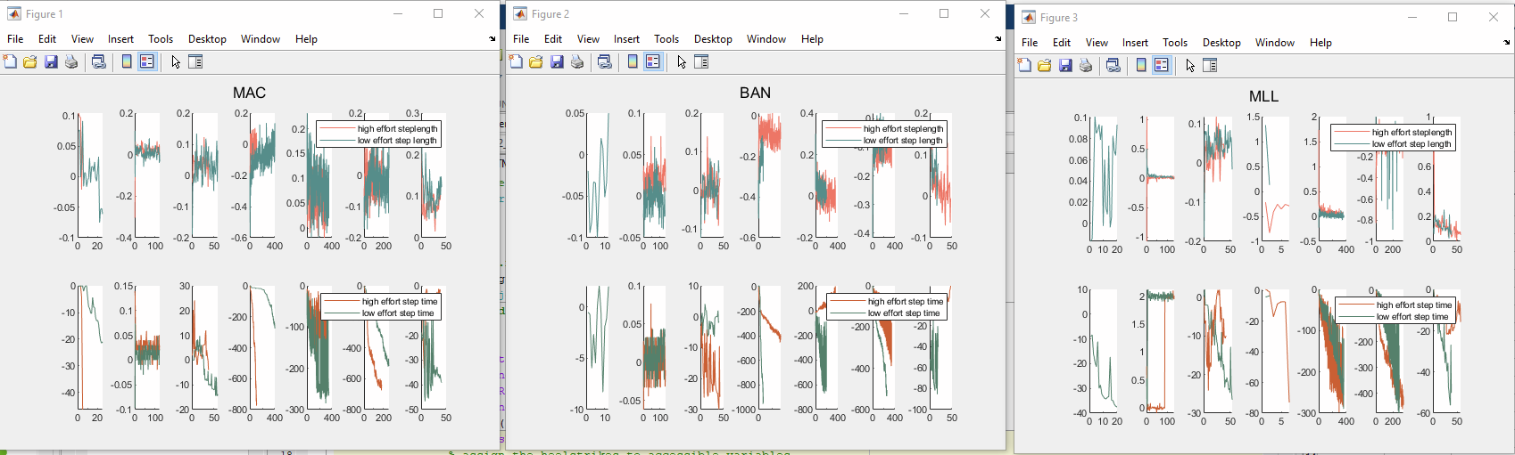
Heel strikes from foot center velocity
Are no better than force only and may be worse

Slide 19
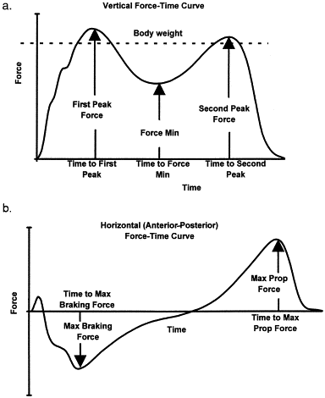
Time-domain analysis of foot–ground reaction forces in negotiating obstacles. Begg 1998
In the following plots : coral is high effort, teal is low effort. Solid lines are first visit and dotted lines are second visit. In the asymmetry plots the three plots are block 4,5,6 proceeding down the column

Slide 20
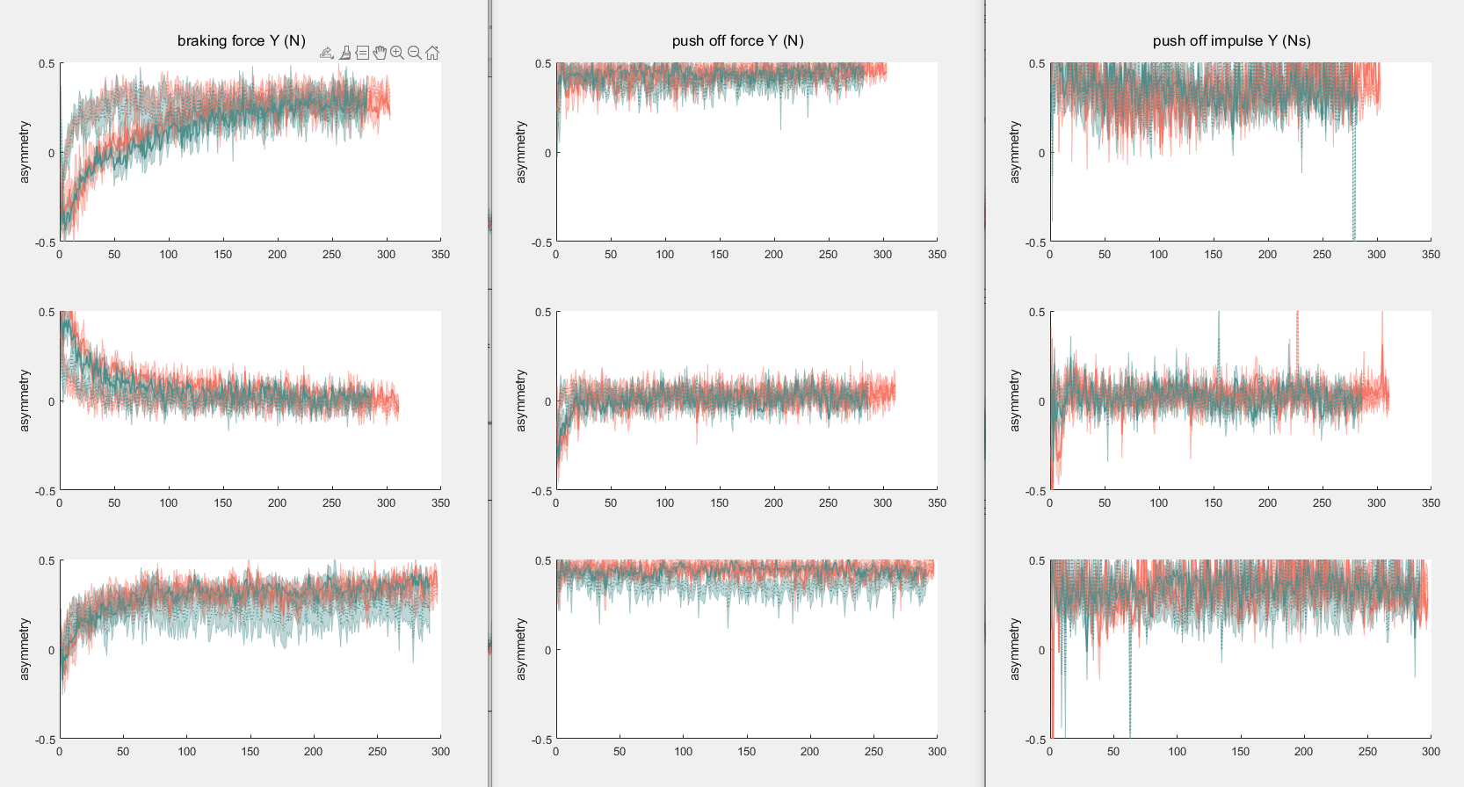
fy
Check y axes on these (push off is biased for visibility)

Slide 21
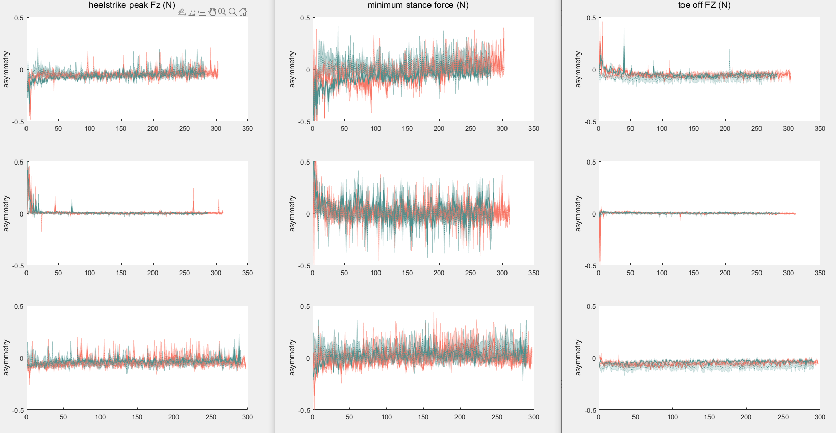
fz

Slide 22
fy

Slide 26
Sample subject – percent gait profiles (subj 11)

